Slide 1

PsychoPy 2 : Experiment Builder
Jibo He
Department of Psychology
jibo.he@wichita.edu

Slide 2
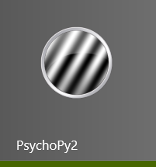
Start PsychoPy
Find the "PsychoPy2" in the Start Menu.

Slide 3
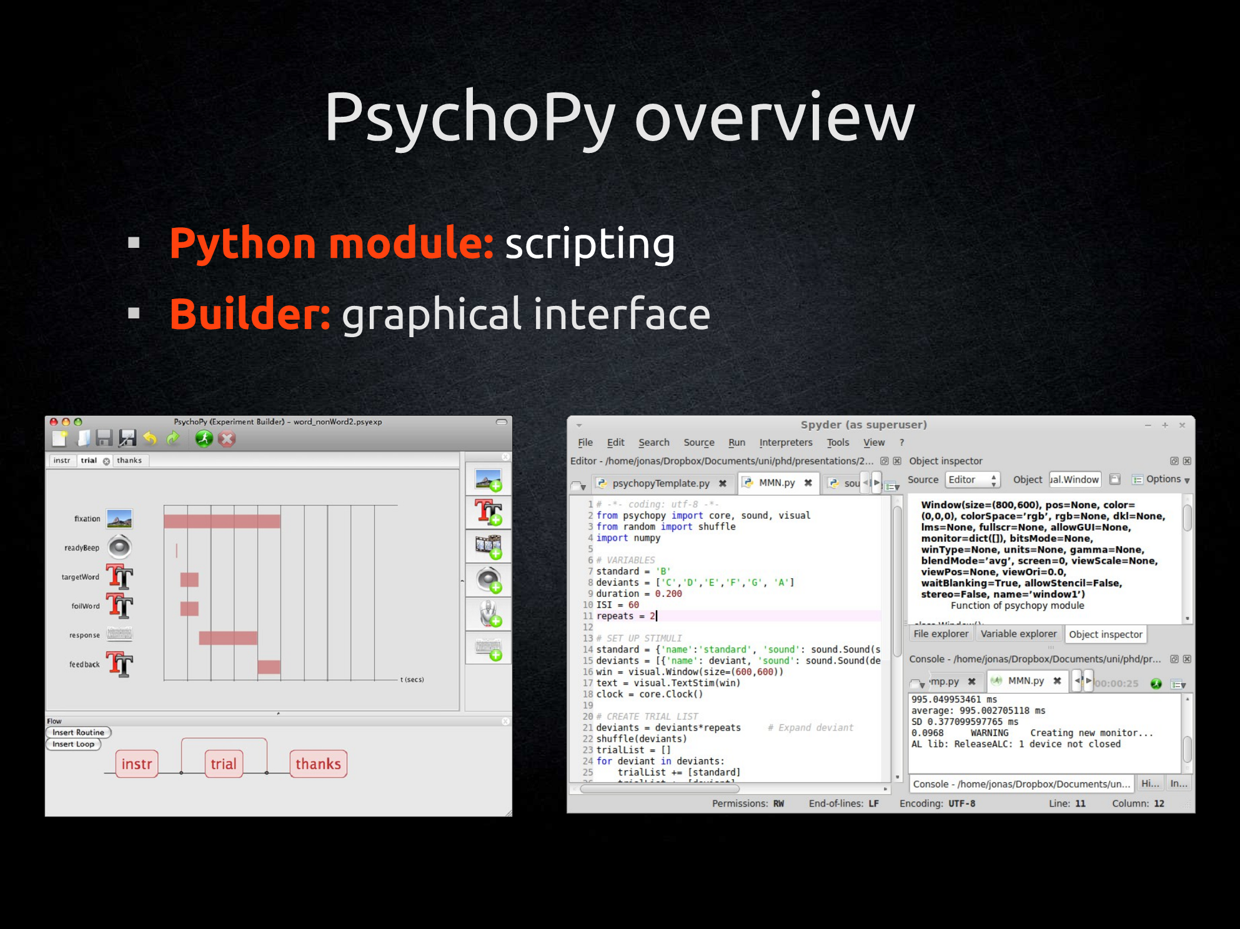

Slide 4
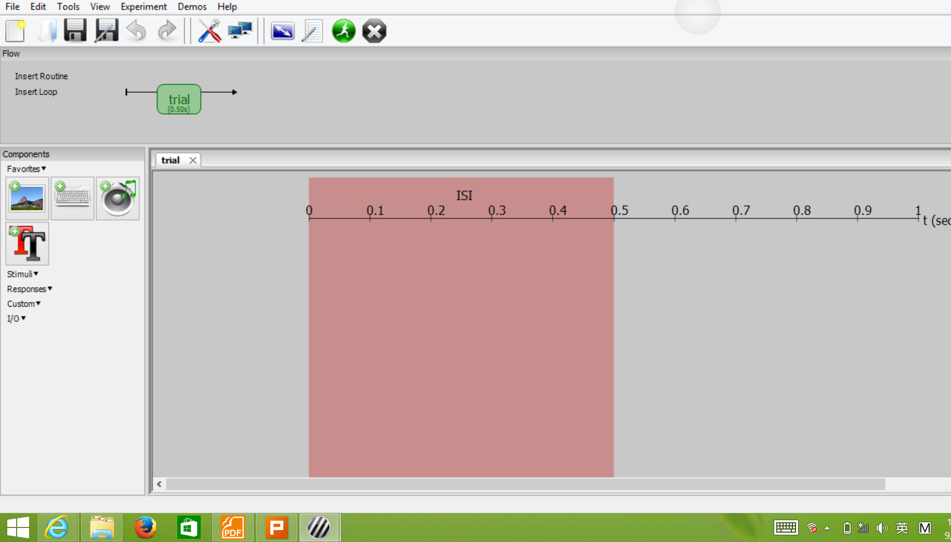
overview of a complete project

Slide 5
interface of PsychoPy Builder

Slide 6
outline
text
show instruction
image
shapes
audio
video
load data source
write data to file

Slide 7
Excercise
Use PsychoPy Builder to develop an auditory version of the N-Back task

